Slide 1
SEO PROJECT Comprehensive SEO Audit & Optimization for Organic Traffic Growth Pushparaj M / BADM-WD-T-B9

Slide 2
About the company
I selected the company “Infosys” (https://www.infosys.com)for this SEO project.
Infosys is a global leader in consulting and managed services. They partner with companies like Amazon Web Services (AWS) to help accelerate business transformation through software, services, and processes. Infosys is known for its strong focus on technological innovation, digital transformation, and AI-first solutions

Slide 3
About the company
Infosys offers a wide range of services across various domains. Here are some of their key service offerings:
Digital Transformation Services
Digital Marketing: Enhancing customer engagement through targeted marketing strategies.
Digital Commerce: Streamlining e-commerce operations for better customer experiences.
Digital Interactions: Creating immersive digital experiences using technologies like virtual and augmented reality.
Insight Services
Data Analytics: Leveraging data to provide actionable insights for business growth.
Applied AI: Implementing AI solutions to drive innovation and efficiency.

Slide 4
About the company
Innovation Services
Blockchain Engineering: Developing secure and transparent blockchain solutions.
Internet of Things (IoT): Connecting devices and systems for smarter operations.
Assurance Services
Cyber Security: Protecting businesses from cyber threats and ensuring digital trust.
Quality Engineering: Ensuring high-quality software development and maintenance.
Consulting Services
Technology Consulting: Offering expert advice on technology strategies and implementations.
Business Process Management: Streamlining and optimizing business processes for better performance.

Slide 5
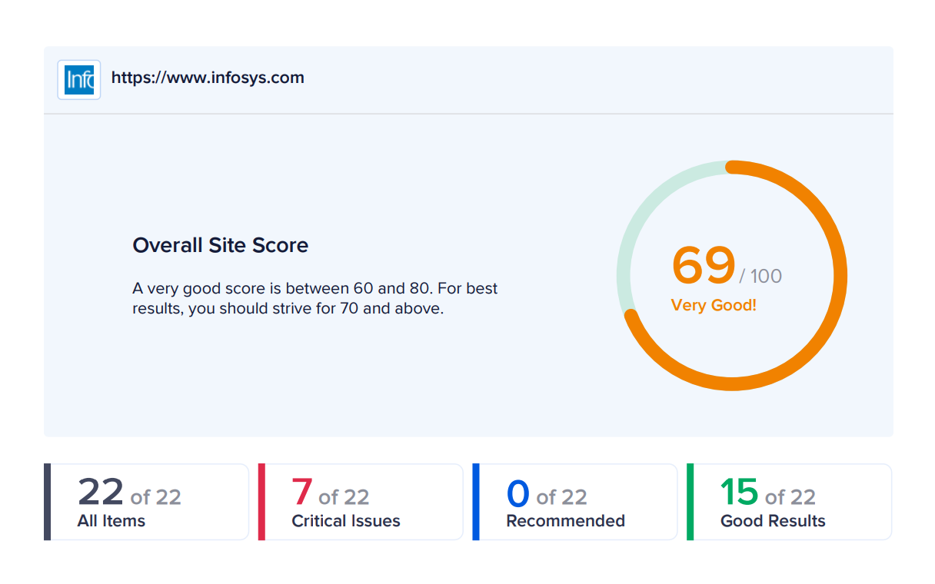
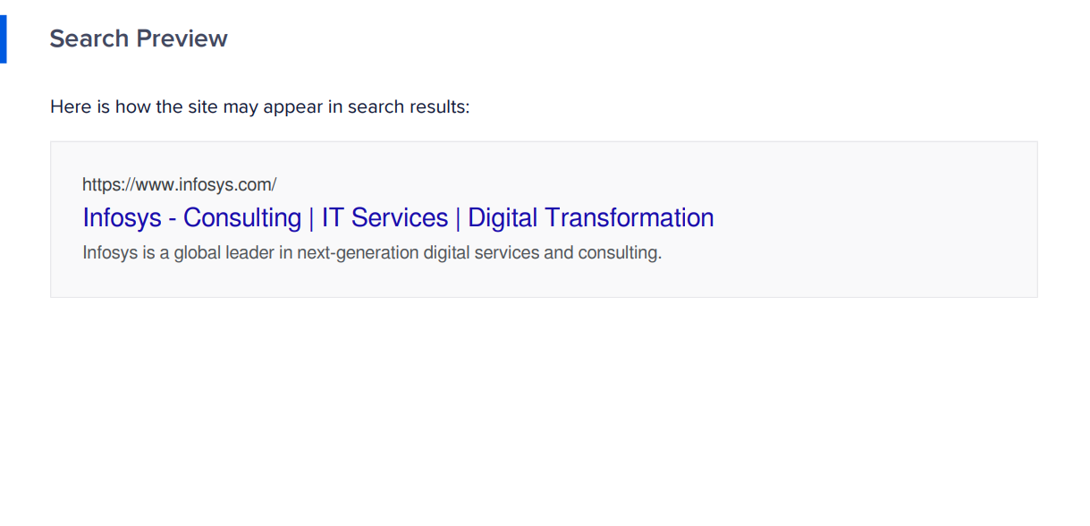
Initial Audit
Current Performance
Infosys has been performing well, overall site score was 69 out of 100.
https://www.infosys.com

Slide 6
Keyword Research
I was choose the “Cyber security “keyword in Infosys company
This word is high search volume and low competition for the company services.
SI.No | Keywords | Search volume
1 | Cyber security | 100k – 1m
2 | Computer security | 10k – 100k
3 | IT security | 1k – 10k
4 | Information Security | 10k – 100k
5 | Cyber threat intelligence | 1k – 10k

Slide 7
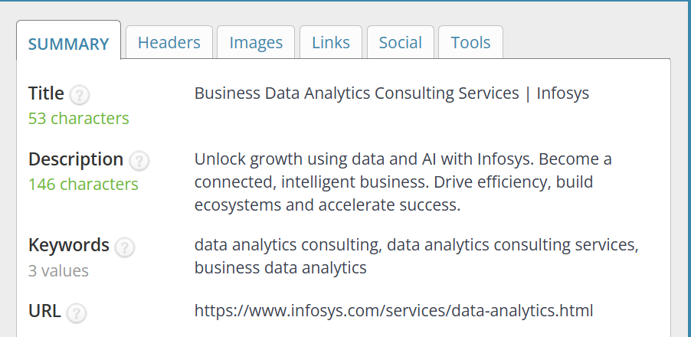
On page SEO Optimization Audit
1st Website
https://www.infosys.com/services/data-analytics.html
Targeted Keyword: Data Analytics and AI
1.Title tags are optimized properly and the description are not optimized properly because the keyword was missing, In html H1 Tag is not have a keyword H2 Tag optimized perfectly.

Slide 8
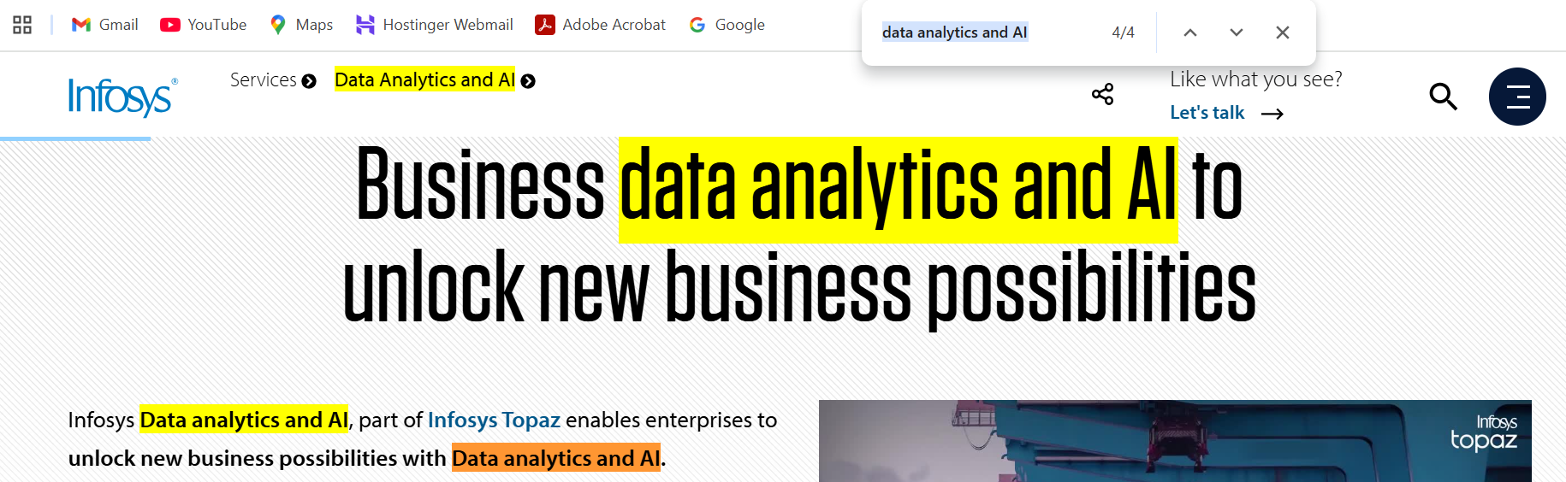
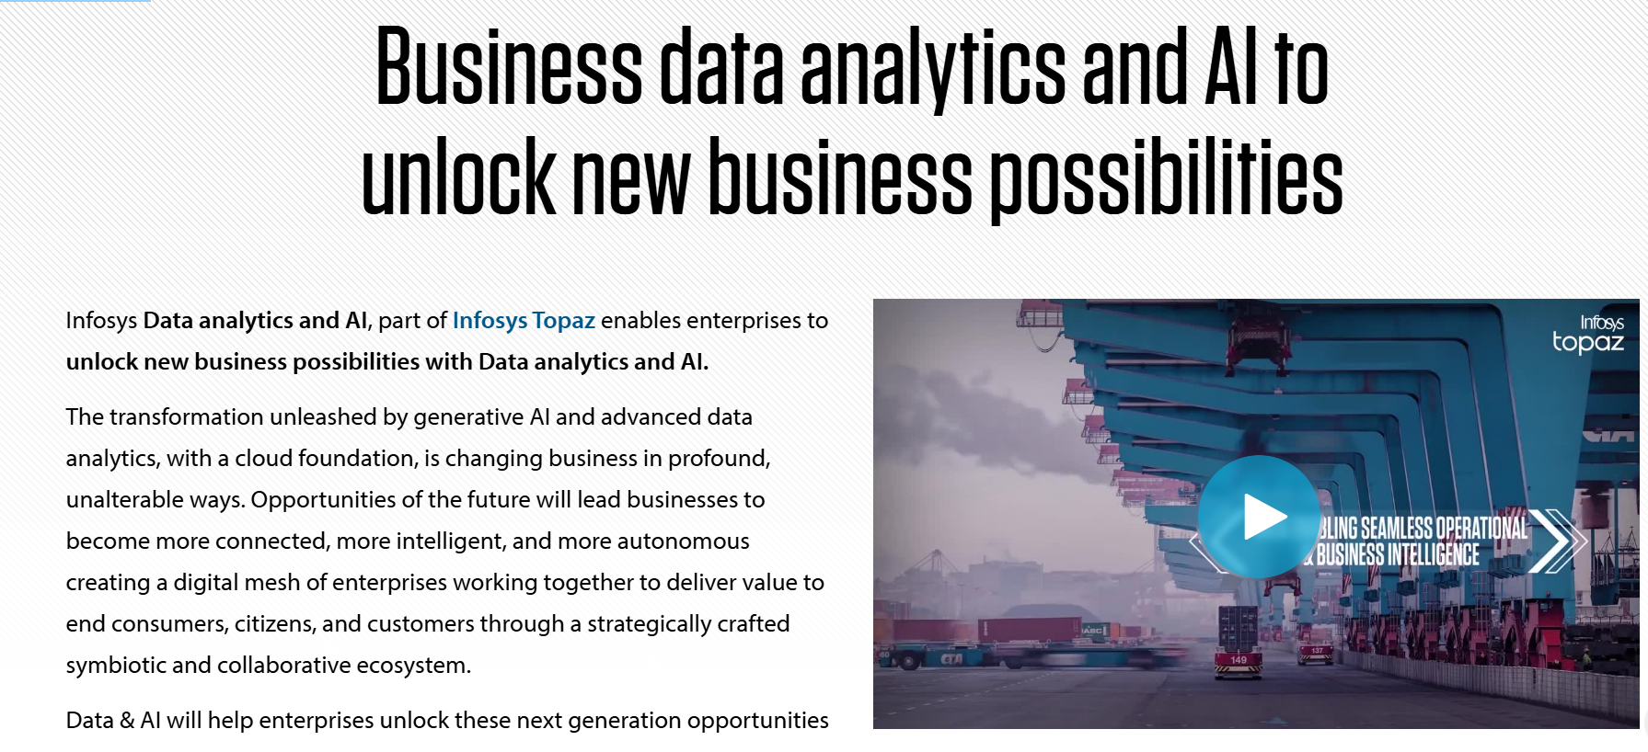
2.Keywords are optimized and used Four times in the content.
3.There is no external linking in this content only having a internal linking in the data analytics and AI page.

Slide 9

4.The images are optimized properly in this page.
https://www.infosys.com/content/dam/infosys-web/en/global-resource/18/banner/ai-imperatives-2024-lead.jpg

Slide 10
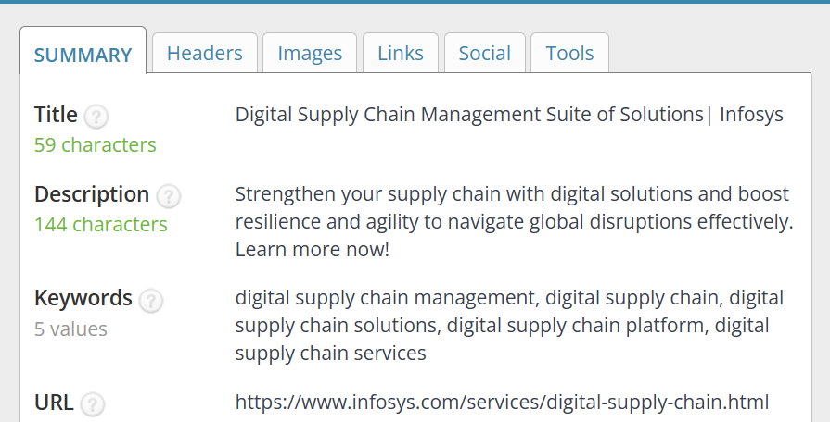
2nd Website
https://www.infosys.com/services/digital-supply-chain.html
Targeted Keyword: Digital supply chain
1.In this digital supply chain website page title tags are optimized properly and the description not optimized, The H1 and H2 tags are optimized properly.

Slide 11
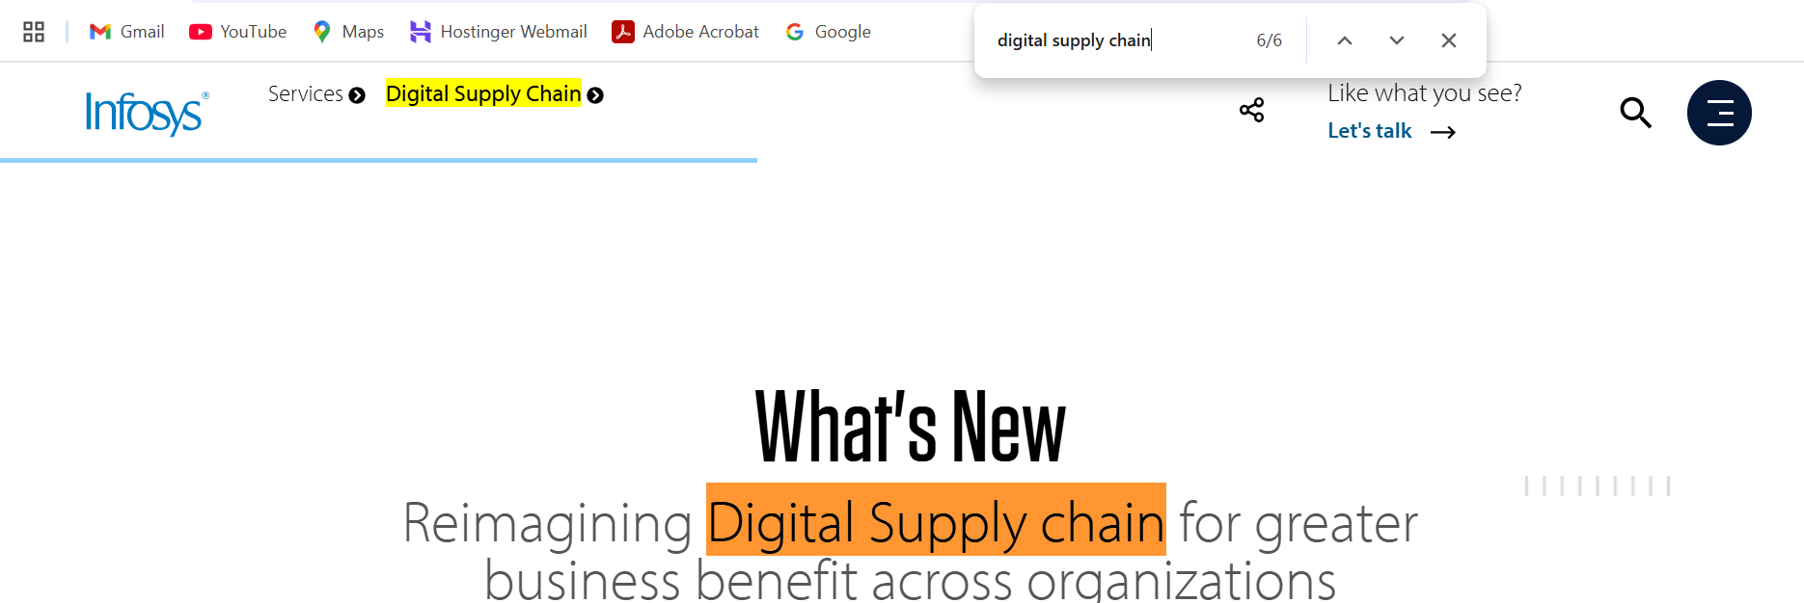
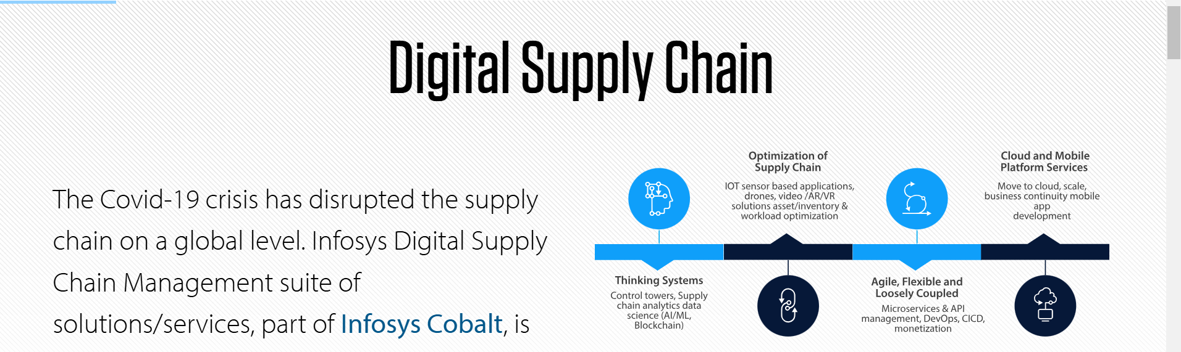
2.The keywords are used more than five times in the content so they are not optimized correctly.
3.In this page there is no external linking only internal linking are there.

Slide 12
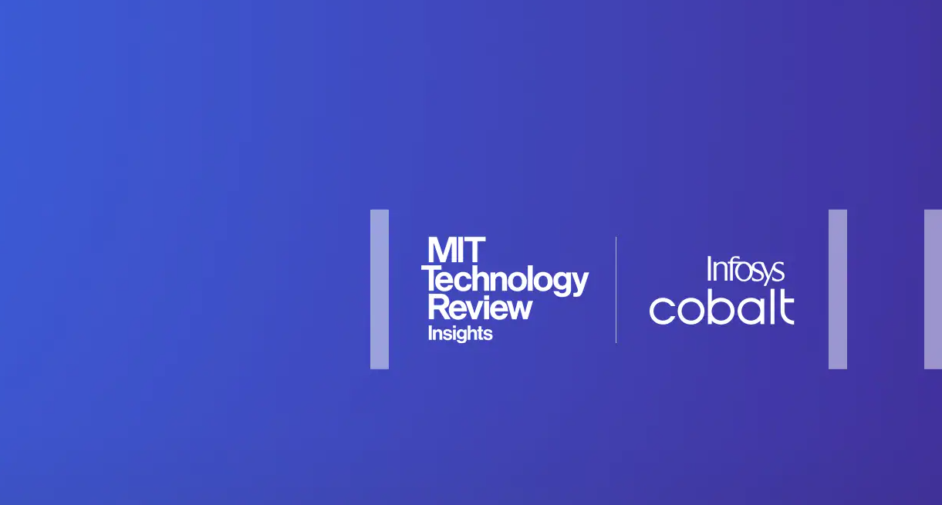
4. The images are optimized perfectly in this website page.
https://www.infosys.com/content/dam/infosys-web/en/global-resource/18/banner/launch-cloud-hub-lead.jpg

Slide 13
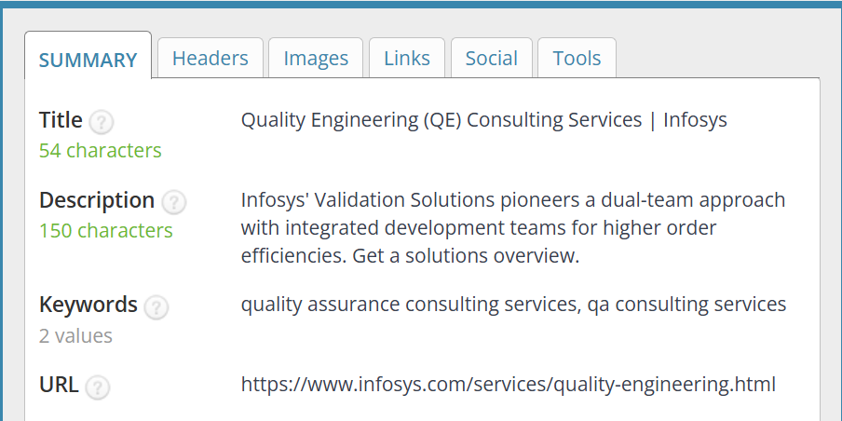
3rd Website
https://www.infosys.com/services/quality-engineering.html
Targeted keyword: Infosys Quality Engineering
1.The title tags are optimized properly descriptions are not optimized because infosys quality engineering keyword is missing, H1 tag optimized and H2 tag is not optimized perfectly.

Slide 14
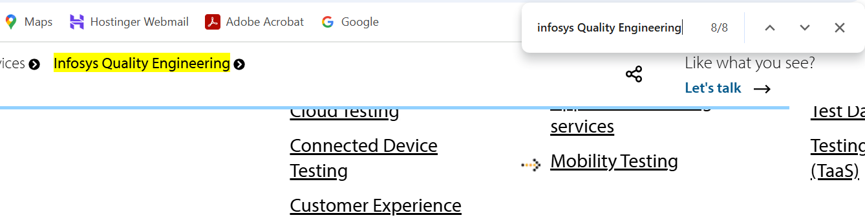
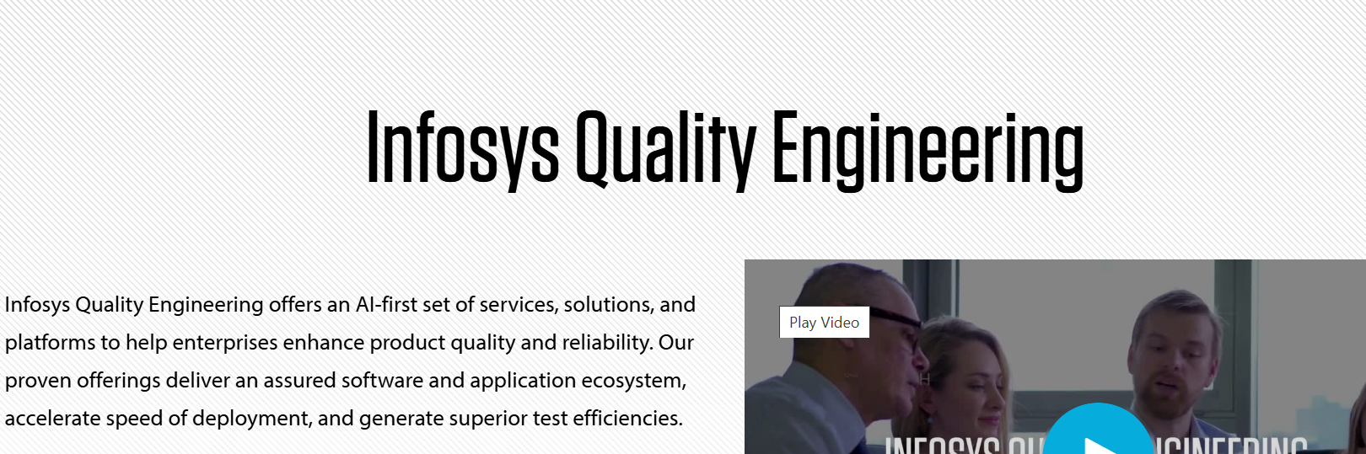
2.Totally there are eight keywords are used in this page so they are not optimized properly.
3.There is no internal and external linking in this website

Slide 15
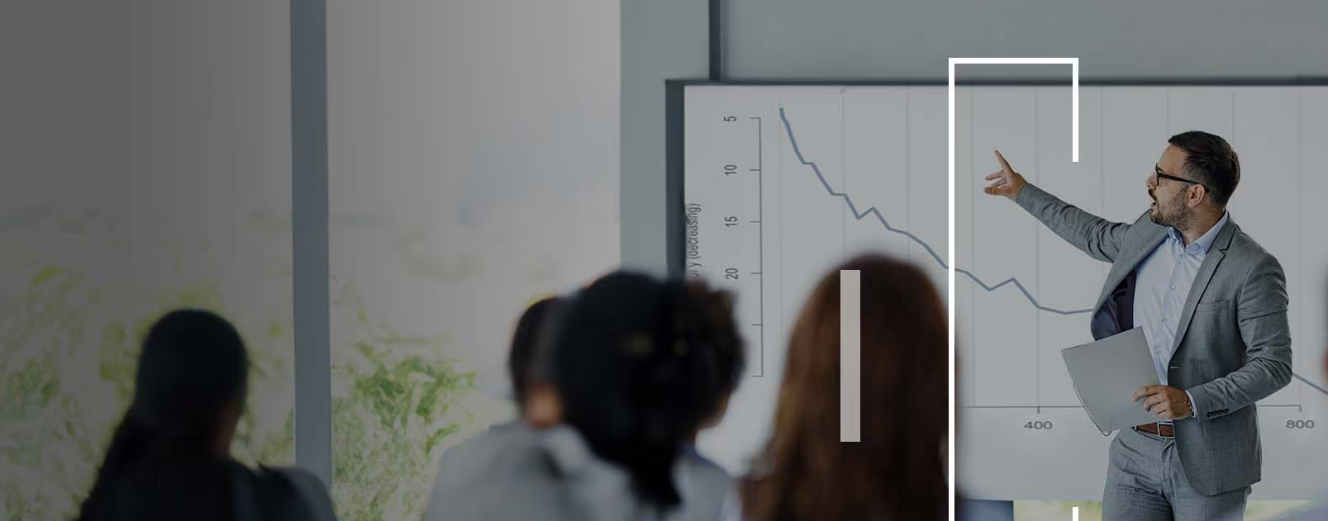
4.The images are optimized properly in this page.
https://www.infosys.com/content/dam/infosys-web/en/global-resource/24/banner/continuous-automation-testing-lead.jpg

Slide 16
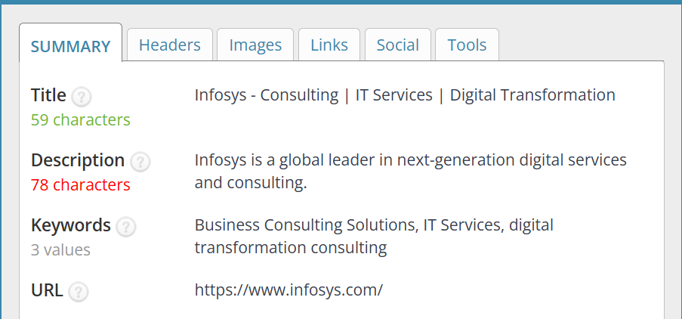
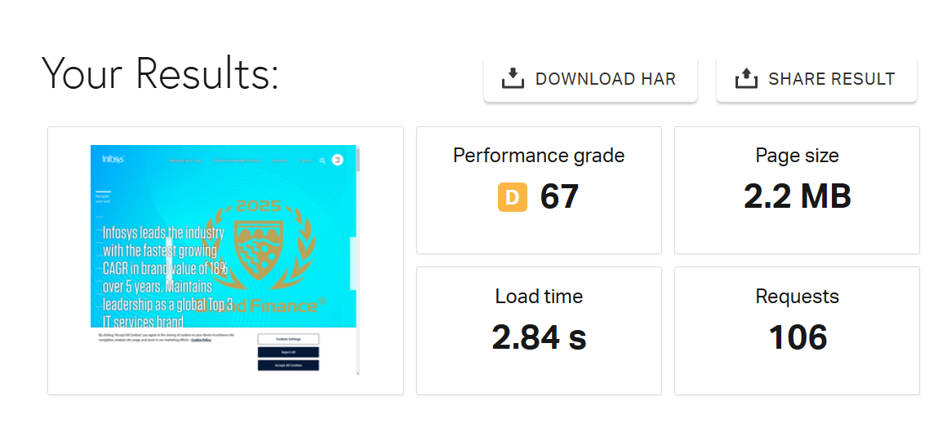
Technical SEO
1.The current Seo status of the Infosys homepage website title tags are optimized perfectly, but the description are not optimized correctly other than keywords used perfectly in this page and the page loading speed other technical Seo optimized properly.

Slide 17
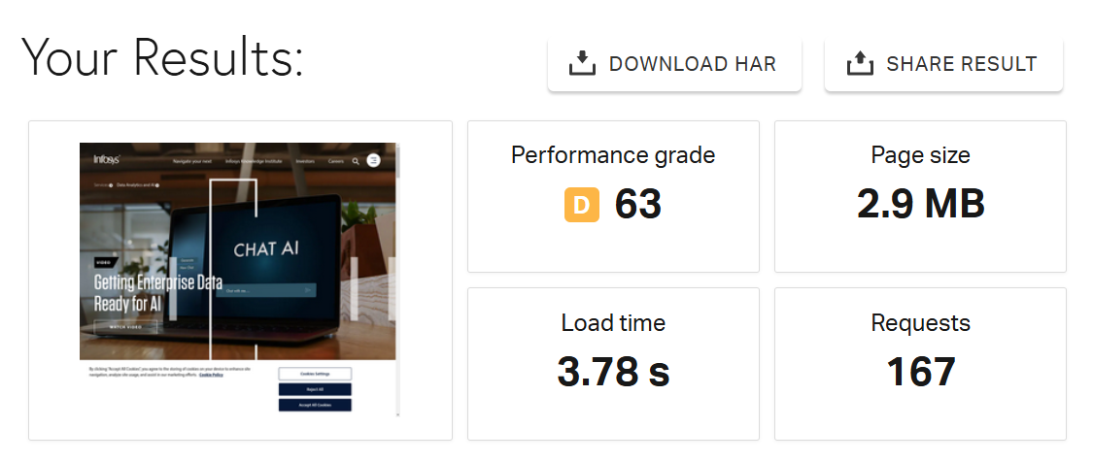
2. This Page is optimized properly and the loading time was less than 5 seconds only
https://www.infosys.com/services/data-analytics.html

Slide 18
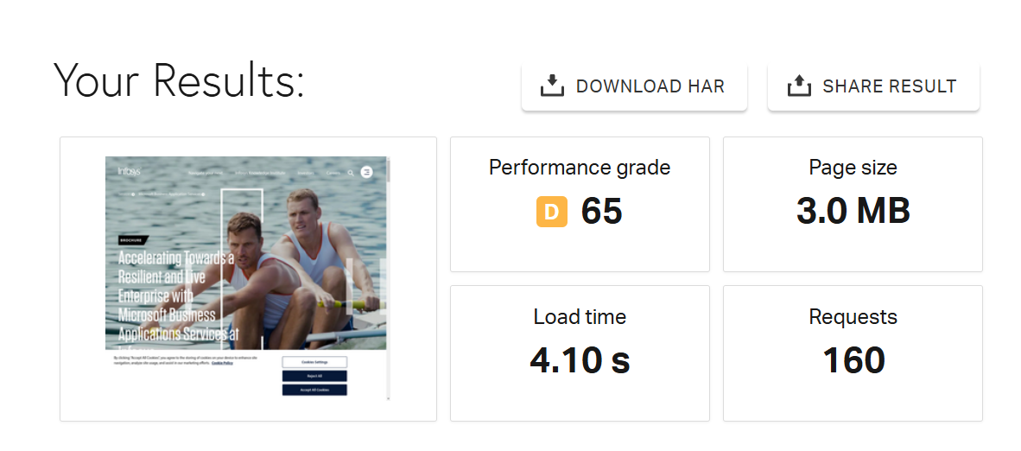
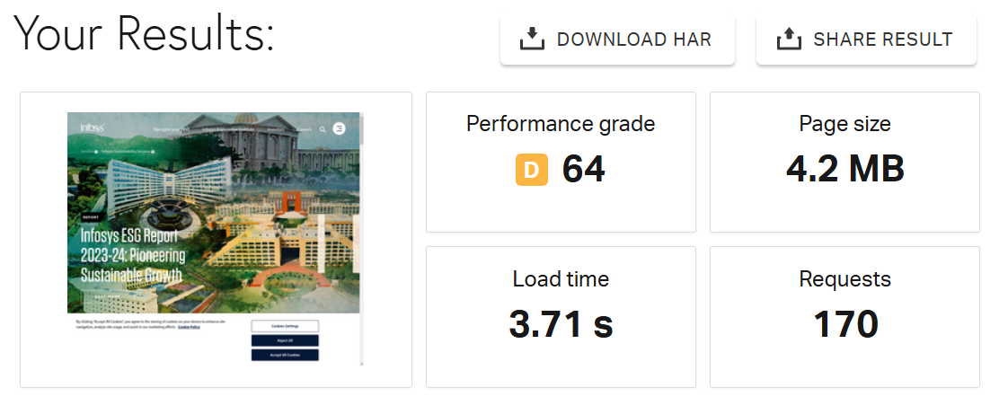
3.In this Infosys website the Microsoft business application services page optimized properly the loading time is 4.10 seconds.
https://www.infosys.com/services/microsoft-dynamics.html
4.The Infosys sustainability services page are optimized perfectly.
https://www.infosys.com/services/sustainability-services.html

Slide 19
5. Best Practices to improve the website and webpage speed
1. Optimize Images:
Compress images using tools like TinyPNG or ImageOptim.
Use appropriate image formats (e.g., JPEG for photos, PNG for graphics with transparency).
2. Minimize HTTP Requests:
Reduce the number of elements on each page.
Combine multiple CSS and JavaScript files into one.
3. Enable Browser Caching:
Set up your server to store static files for a specific period.
Use a content delivery network (CDN) to cache and deliver content more quickly.
4. Minify CSS, JavaScript, and HTML:
Remove unnecessary characters, spaces, and comments from your code.
Tools like UglifyJS (for JavaScript) and CSS Nano (for CSS) can help.
5. Use Asynchronous Loading for CSS and JavaScript:
Implement asynchronous loading to prevent scripts from blocking rendering.
Use the async and defer attributes in your script tags.

Slide 20
Content Strategy
The Importance of Cyber Security: Protecting Your Digital World
In today’s interconnected world, cyber security has become a critical concern for individuals, businesses, and governments alike. As we rely more on technology for communication, commerce, and daily activities, the need to protect our digital assets from cyber threats has never been more important.

Slide 21
Off Page SEO
1. Build Quality Backlinks:
Guest Posting: Contribute high-quality articles to reputable industry blogs and websites. Ensure the content is relevant and includes a backlink to the Infosys website.
Content Partnerships: Collaborate with other businesses and influencers in the tech industry to create joint content that includes backlinks.
2. Leverage Social Media:
Share Content: Regularly share Infosys’ blog posts, case studies, and news on social media platforms like LinkedIn, Twitter, and Facebook.
Engage with Followers: Respond to comments, participate in discussions, and engage with industry leaders to increase visibility and drive traffic to the website.
3. Utilize Online Directories:
Business Directories: Submit Infosys to relevant online directories such as Crunchbase, LinkedIn, and industry-specific directories.

Slide 22
THANK YOU

